Slide 1


Slide 2






Slide 3


Slide 4










Slide 6
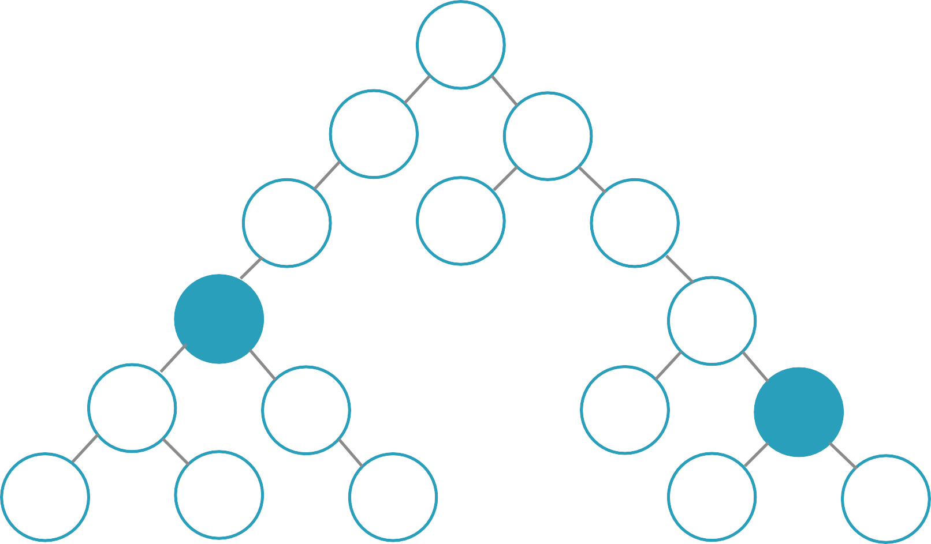

Slide 7






Slide 8
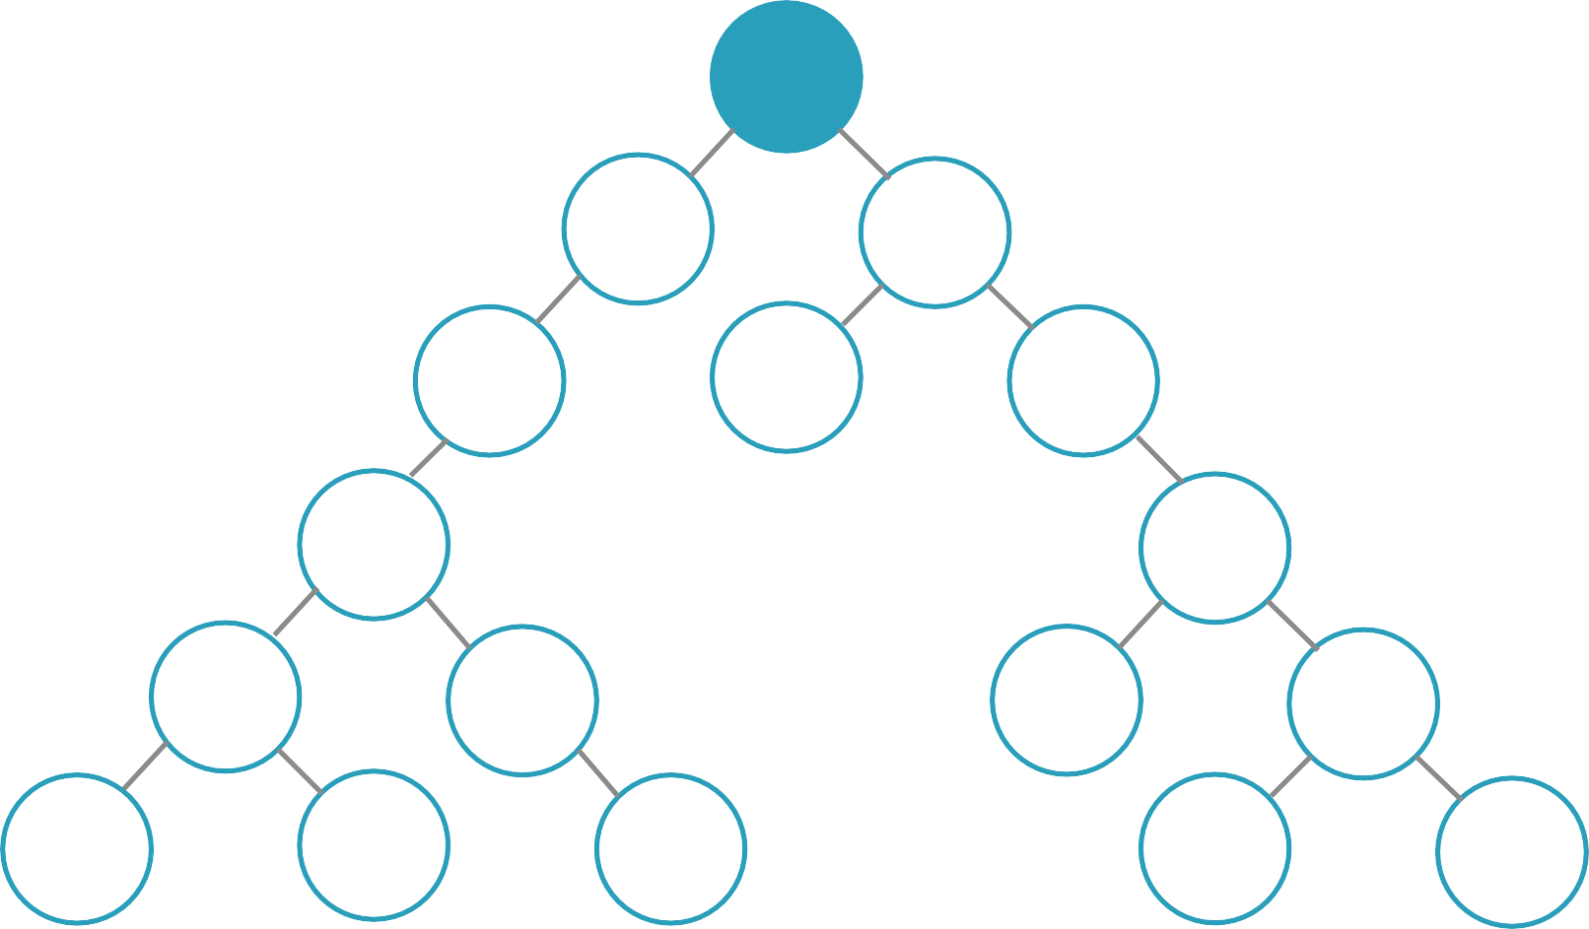

Slide 9
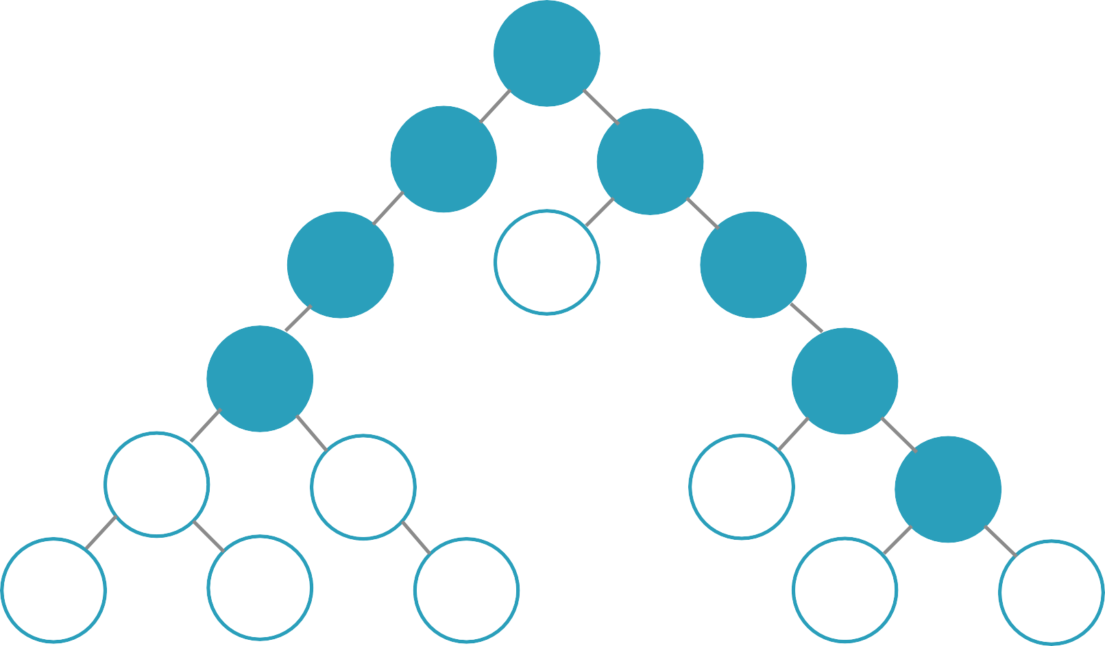

Slide 10
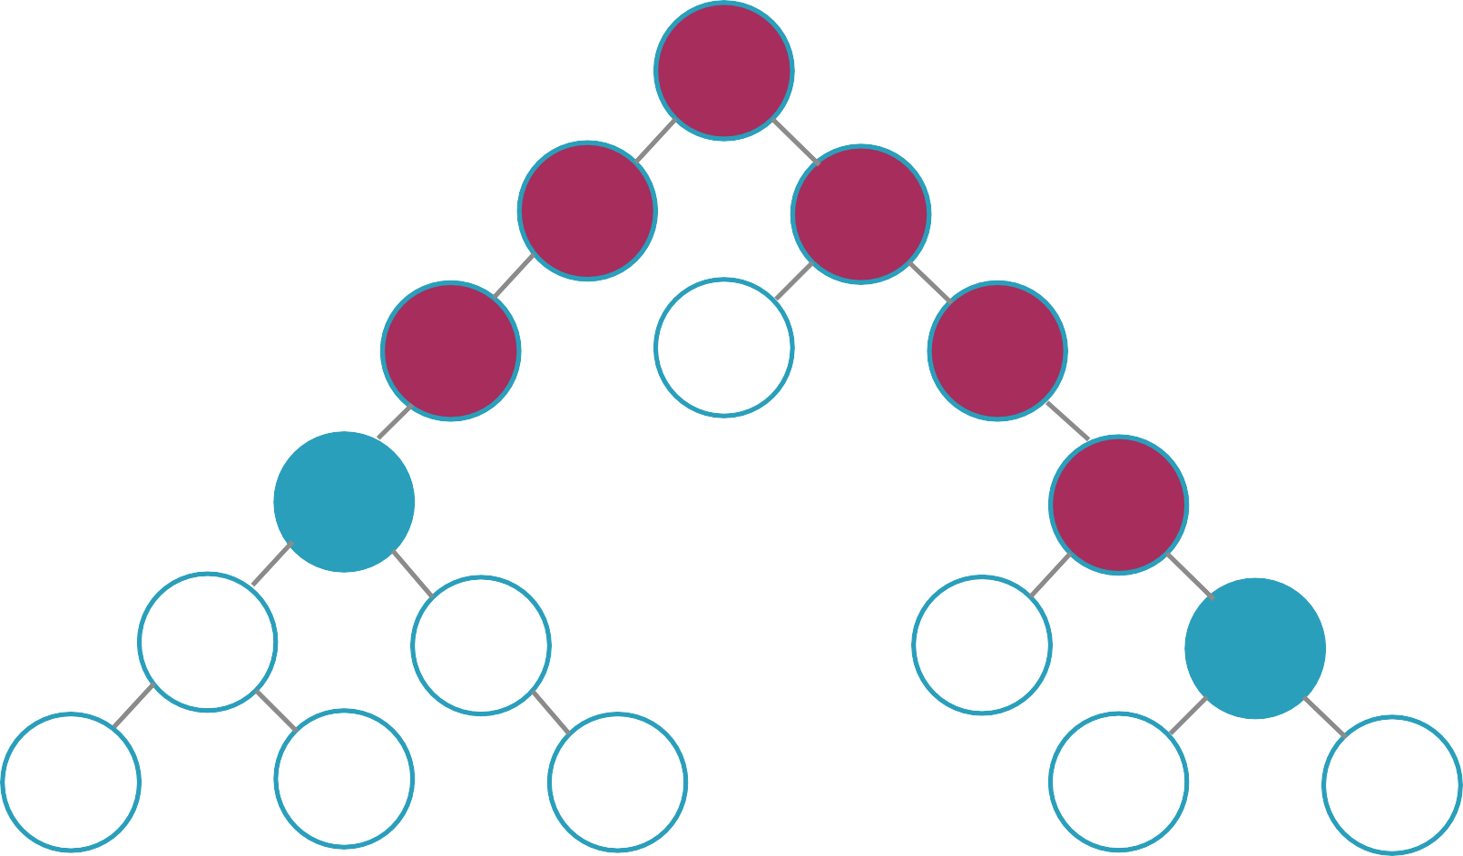


☹

Slide 11




Slide 12








Slide 13





Slide 14


Slide 15








Slide 16





Slide 17






Slide 18













Slide 19


Slide 20






{ type: RATE_COURSE, rating: 5 }
function appReducer(state = defaultState, action) { switch(action.type) {
case RATE_COURSE:
//return new state
}
}

Slide 21



-
-
-

